Slide 1
Following christ
Learn . Believe . Experience . Become. Do . Share

Slide 2
followership if you do it, you don’t need a definition.
But if you don’t do it… no definition will help.

Slide 3
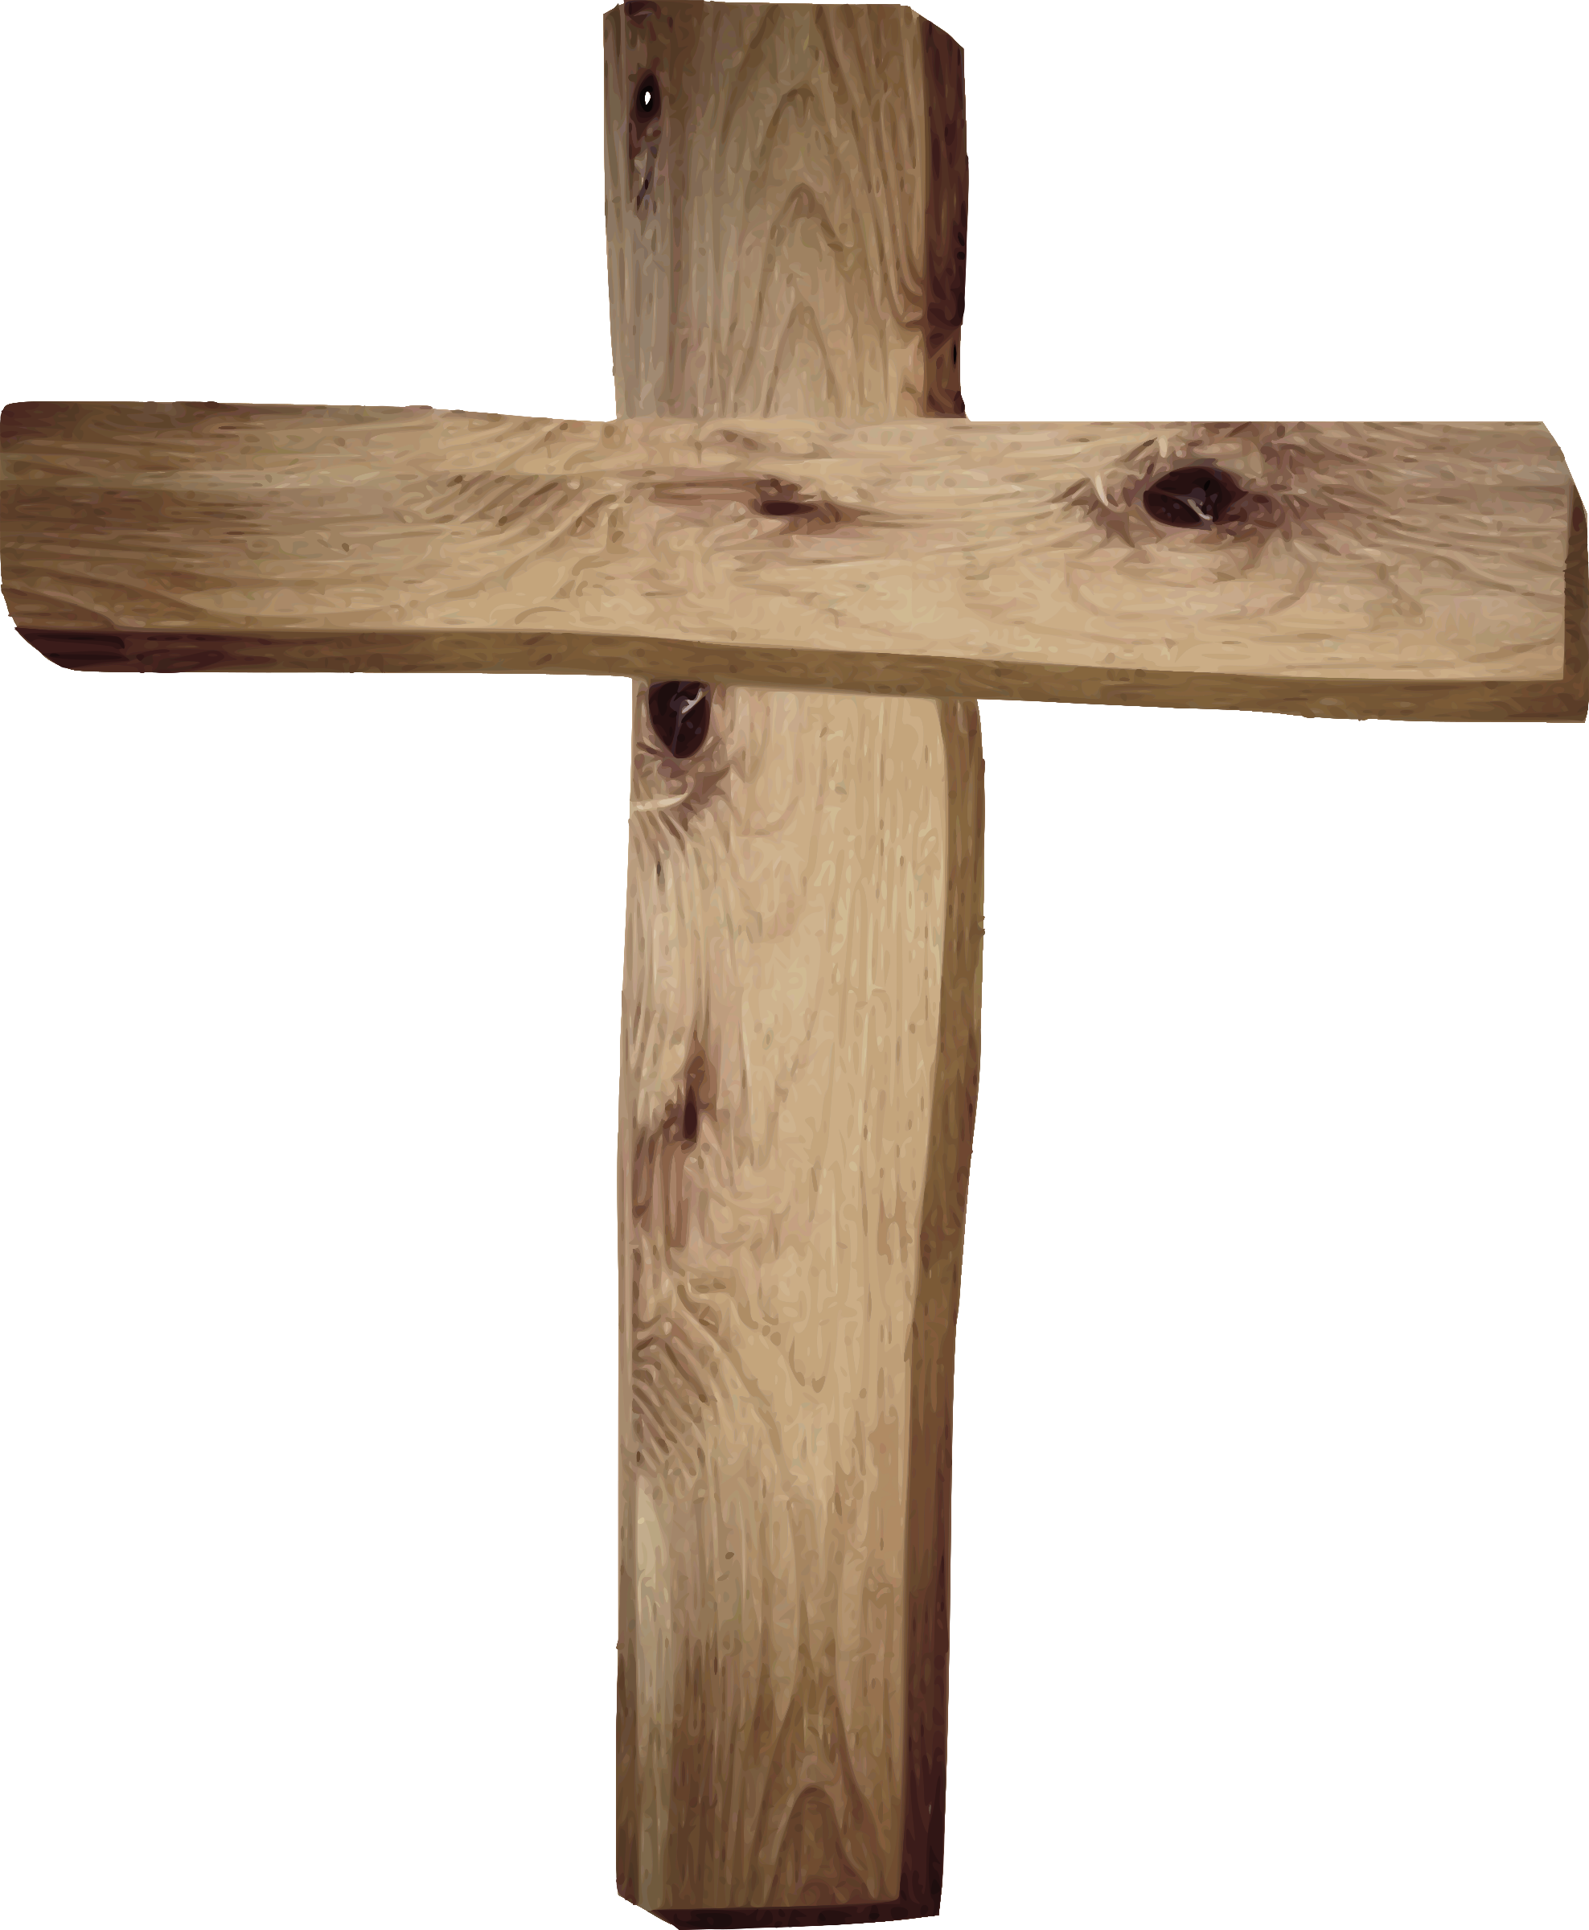
Following means growing up & out
Vertically
Be Reconciled to CHRIST
Jesus grew in favor with God
Romans 5:10
Horizontally
Be Reconciled to PEOPLE
Jesus grew in favor with man
Matthew 5:24 & 25:40

Slide 4
This is where discipleship comes in
Belief
Relationship
Conviction
Mystery

Slide 5
First two tenants of discipleship Luke 2:52
Belief
Relationship
“Ignorance on fire is a scary thing!”
Romans 10:2 …(“have a zeal for God, but not according to knowledge.”)
This is the intellectual dimension of discipleship – the LEARNING
I KNOW the right things
Accountability happens in the context of relationships.
John 13:35 (… “they will know you by the love you have towards one another.”)
Community is where knowledge is practiced and observed – the DOING
I DO the right things
Notes:
At the end of section bullets, ask the question “What does this look like?” (i.e. Read my bible, hear & examine preaching, attend study, etc.”

Slide 6
Last two tenants of discipleship Luke 2:52
Conviction
Mystery
We don’t follow Christ out of duty, but out of passion
2 Corinthians 5:14
Passion and personal conviction drive our obedience
My MOTIVES are pure. I have the right passion and conviction to motivate me
The role of the HOLY SPIRIT
We cannot order, manipulate or control this dimension
“[We] plan, plant and water, but God gives the increase”
1 Corinthians 3:6-7; 1 Thessalonians 5:23 – Growth (sanctification) is under God’s control and in His timing

Slide 7
Spiritual formation – how we grow
The INTELLECT finds God in the pages of a book
The NATURALIST grows closer to God at the edge of the ocean
The ENTHUSIAST encounters God in full-throttle, unashamed worship
The ASCETIC grows spiritually in places of quiet solitude
ONE SIZE DOES NOT FIT ALL

Slide 8
Spiritual formation – how we grow
PAUL was theologically sound and well-trained in biblical instruction
THOMAS needed to see, touch and speak with God
PETER had a short fuse; Jesus had to repeat things to him often. He wept deeply when he realized his wrongs and he was eventually martyred. He grew most deeply when he was passionately engaged with Christ.
WE ALL GROW DIFFERENTLY

Slide 9
What will it cost me?
“Thy Kingdom Come” means “My Kingdom Goes”
Luke 14:26-27 & 14:33
We deny our agenda and comfort and accept the greater life that God has planned for us

Slide 10
Fully devoted follower
Youthworker.com | Larry Lindquist (May 2020)
Notes:
Where would you say you are today in this journey? (Return to slide 4)

